Slide 1
Creating SmartArt Graphics
Microsoft Powerpoint 2013
Lesson 7

Slide 2
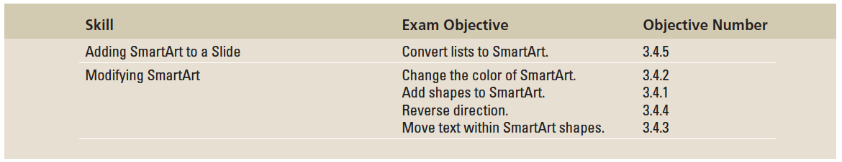
Objectives

Slide 3
Step by Step: Create SmartArt
GET READY. Before you begin these steps, make sure that your computer is on. Log on, if necessary.
START PowerPoint, if the program is not already running.
Locate and open the Litware presentation and save it as Litware Final.
Go to slide 3, and click the Insert SmartArt Graphic icon in the center of the content placeholder. The Choose a SmartArt Graphic dialog box opens.
Click Hierarchy in the type list in the left side of the dialog box. The layouts for the Hierarchy type are displayed.
Notes:
Another Way: To insert SmartArt on a slide that does not have a content placeholder, click the SmartArt button on the Insert tab.

Slide 4
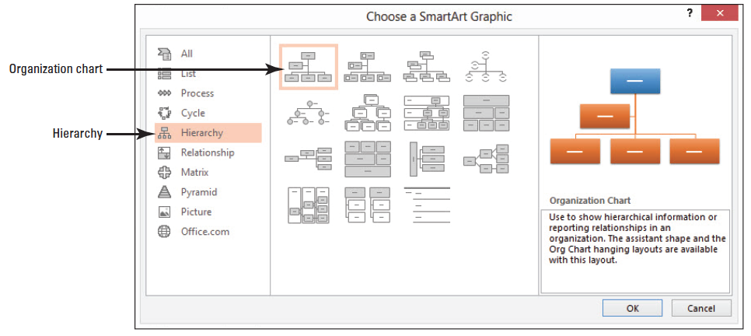
Step by Step: Create SmartArt
Click the first layout in the first row, the Organization Chart. Read the description of the Organization Chart layout in the right pane of the dialog box (see the figure below).

Slide 5
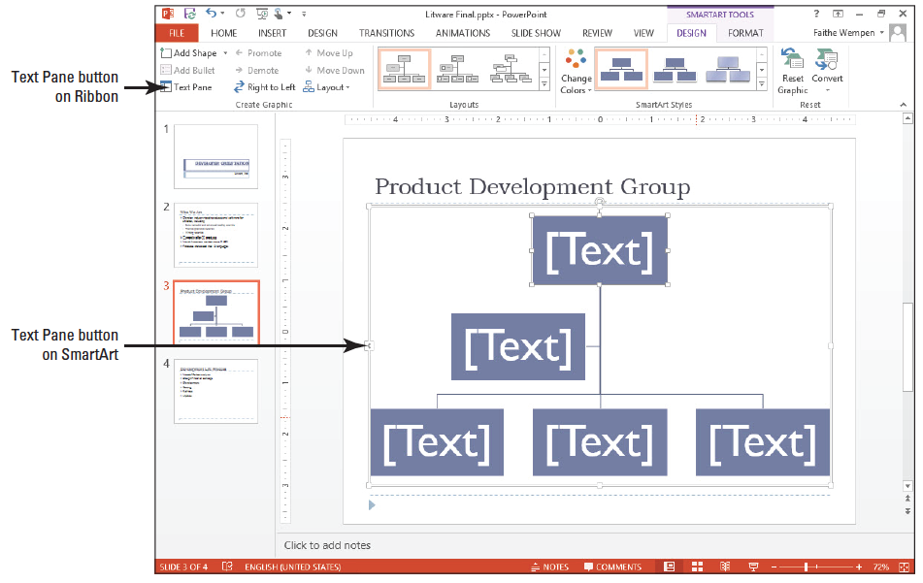
Step by Step: Create SmartArt
Click OK to insert the chart. The chart appears on the slide (see the figure below).
SAVE the presentation.
PAUSE. LEAVE the presentation open for the next exercise.

Slide 6
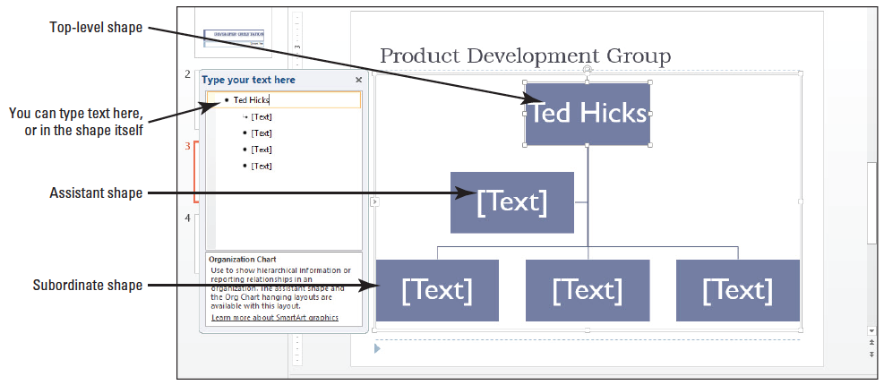
Step by Step: Add Text to SmartArt
USE the Litware Final presentation that is still open from the previous exercise.
Click Text Pane on the SmartArt Tools Design tab. This opens the Text pane.
At the top of the text pane, type Ted Hicks to enter the name in the top-level shape. Notice that as you type the text in the Text pane, it appears in the top shape (see the figure below), and that the text automatically resizes to fit in the shape.
Notes:
Another Way: You can also display or hide the Text pane by clicking the arrow symbol on the left side of the SmartArt’s frame.

Slide 7
Step by Step: Add Text to SmartArt
Click in the bullet item below Ted Hicks in the Text pane, then type Rose Lang. Rose Lang is an assistant to Ted Hicks, and as such, she has an assistant shape on a level between the top-level shape and the subordinate shapes.
Click in the next bullet item in the Text pane and type Marcus Short. Marcus Short is a subordinate to Ted Hicks.
Click in the next bullet item and type Ellen Camp.
Click in the last bullet item and type Pat Cramer.
Click the Close button (X) in the Text pane to hide it. You will complete the text entry by typing directly in the shapes.
Notes:
Troubleshooting: Do not press Enter after typing the names because that inserts a new shape. If you accidentally do so, click the Undo button on the Quick Access Toolbar to undo the addition.
Another Way: You can also hide the Text pane by clicking the arrow symbol on the left side of the SmartArt’s frame, or by clicking the Text Pane button again on the SmartArt Tools Design tab.

Slide 8
Step by Step: Add Text to SmartArt
Click just to the right of the name Hicks in the top-level shape, press Enter, and type Director. Notice that the text size adjusts in all the shapes to account for the additional entry in the top-level shape.
Click after the name Lang in the assistant shape, press Enter, and type Assistant Director.
Use the same process to type the title Reading Products for Marcus Short, Linguistics Products for Ellen Camp, and Writing Products for Pat Cramer.

Slide 9
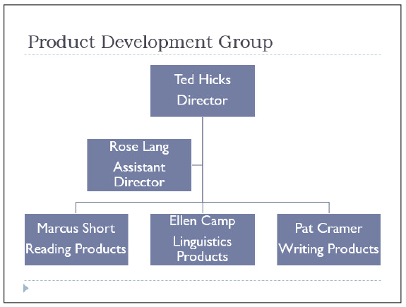
Step by Step: Add Text to SmartArt
Click away from the SmartArt to deselect it. Your slide should look similar to the figure at right.
SAVE the presentation.
PAUSE. LEAVE the presentation open to use in the next exercise.

Slide 10
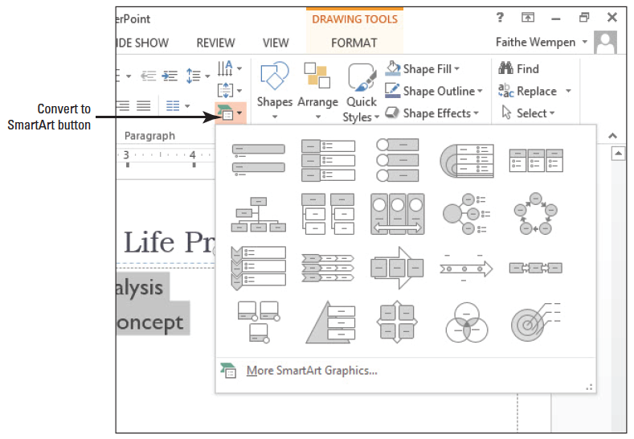
Step by Step: Convert Text or WordArt to a SmartArt Graphic
USE the Litware Final presentation that is still open from the previous exercise.
Go to slide 4 and select the bulleted list.
Click the Home tab, if necessary, and then click the Convert to SmartArt button in the Paragraph group. PowerPoint displays the gallery (seethe figure above).
Notes:
Another Way: Right-click in a bulleted list, and then click Convert to SmartArt on the shortcut menu.

Slide 11
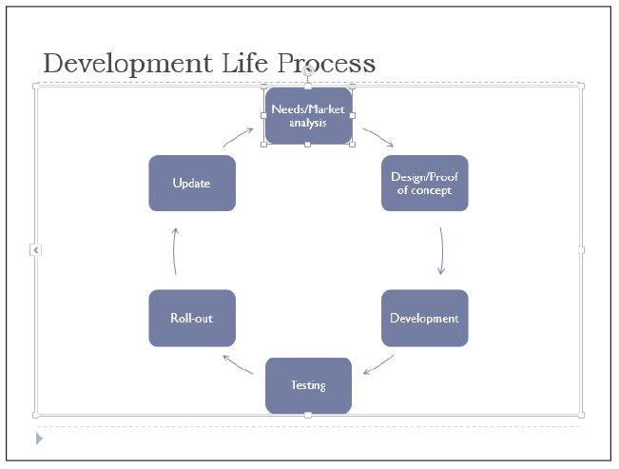
Step by Step: Convert Text or WordArt to a SmartArt Graphic
Click More SmartArt Graphics… at the bottom of the gallery. The Choose a SmartArt Graphic dialog box opens.
Click Cycle, and then click the Block Cycle layout (third layout in the first row). Read the description of how best to use the Block Cycle layout.
Click OK. The bulleted list is converted to a cycle graphic (see the figure above).
Notes:
Take Note: You may notice that the text in the shapes is quite small. You will learn how to modify shape and text size later in the lesson.

Slide 12

Step by Step: Convert Text or WordArt to a SmartArt Graphic
Go to slide 1, and triple-click the Developer Orientation WordArt object to select it.
On the Home tab, click Convert to SmartArt, then click Vertical Bullet List (the first layout in the first row). The WordArt text is converted to a single-item SmartArt object (see the figure below).
SAVE the presentation.
PAUSE. LEAVE the presentation open to use in the next exercise.

Slide 13
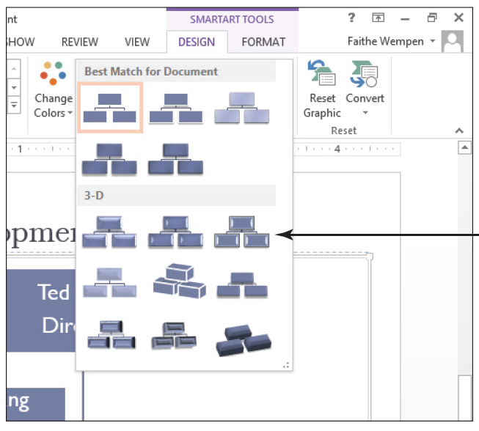
Step by Step: Apply a Style to SmartArt
USE the Litware Final presentation that is still open from the previous exercise.
Go to slide 3 and click once on the SmartArt graphic to select it. Take care to select the SmartArt itself, and not a particular shape within it.
Click the SmartArt Tools Design tab to activate it.
Click the More button in the SmartArt Styles group. The SmartArt Style gallery appears (see the figure above).

Slide 14
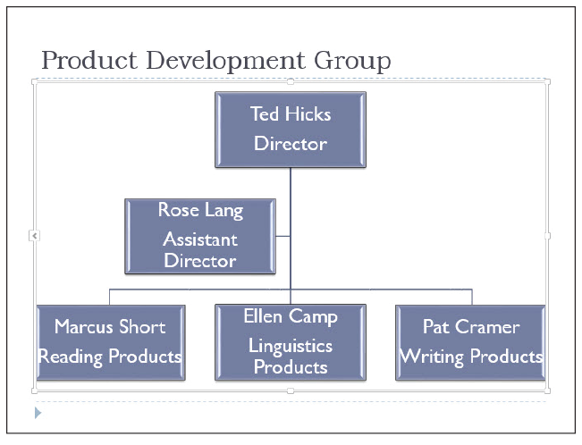
Step by Step: Apply a Style to SmartArt
Click the Cartoon style. (It is the third style in the first row of the 3-D section.) PowerPoint applies the style (see the figure at right).
Go to slide 1, click the SmartArt object, and repeat steps 2-4 to apply the same style.

Slide 15
Step by Step: Apply a Style to SmartArt
Go to slide 4, click the SmartArt object, and repeat steps 2-4 to apply the same style.
SAVE the presentation.
PAUSE. LEAVE the presentation open to use in the next exercise.

Slide 16
Step by Step: Apply a Color Theme to a SmartArt Graphic
By default, SmartArt uses variants of a single theme color. Use the Change Colors gallery to apply a different theme color.
USE the Litware Final presentation that is still open from the previous exercise.
Go to slide 3 and click the SmartArt graphic to select it. Click the SmartArt Tools Design tab.
Click the Change Colors button in the SmartArt Styles group. The Change Colors gallery opens.

Slide 17
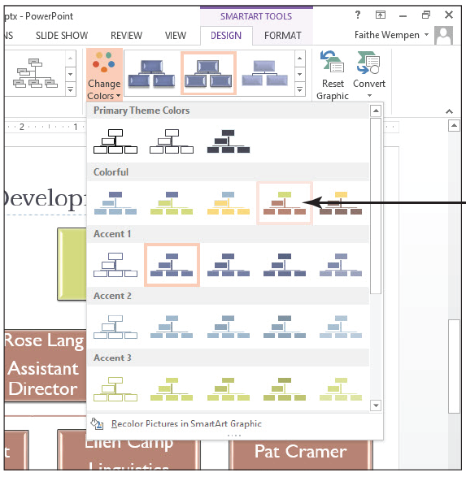
Step by Step: Apply a Color Theme to a SmartArt Graphic
Click the fourth style in the Colorful section (Colorful Range – Accent Colors 4 to 5). PowerPoint applies theme colors differentiated by level (see the igure at right).
Go to slide 4 and click the SmartArt graphic to select it.
Notes:
Take Note: Differentiating levels or processes by color gives your audience further visual cues that help them understand the SmartArt graphic.

Slide 18
Step by Step: Apply a Color Theme to a SmartArt Graphic
Click the Change Colors button in the SmartArt Styles group, opening the Change Colors Gallery, and then click the first style in the Colorful section (Colorful Accent Colors). PowerPoint uses theme colors to apply different tints to each shape.
SAVE the presentation.
PAUSE. LEAVE the presentation open to use in the next exercise.

Slide 19
Step by Step: Change a SmartArt Layout
USE the Litware Final presentation that is still open from the previous exercise.
Click the SmartArt graphic on slide 4 to select it, if necessary. Make sure you select the outer frame of the graphic—not an individual shape.
Click the More button in the Layouts group to display the Layouts gallery.
Notes:
Take Note: The Layouts gallery displays alternative layouts for the current type.

Slide 20
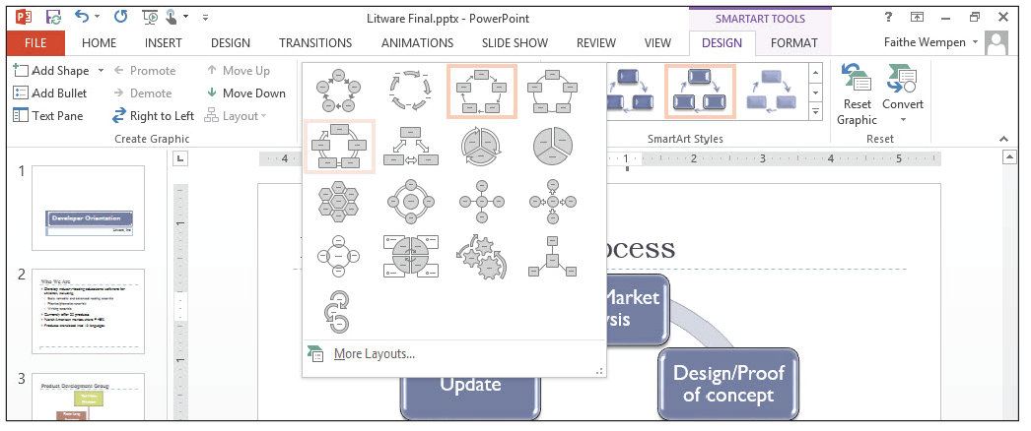
Step by Step: Change a SmartArt Layout
Click Continuous Cycle (see the figure below). It is the first layout in the second row. PowerPoint applies the new cycle layout to the current chart (see the figure on the next slide).
SAVE the presentation.
PAUSE. LEAVE the presentation open to use in the next exercise.

Slide 21

Step by Step: Change a SmartArt Layout

Slide 22
Step by Step: Add a Shape to a SmartArt Graphic
USE the Litware Final presentation that is still open from the previous exercise.
Go to slide 3 and click the SmartArt graphic to select it. Make sure you select the graphic’s outer frame, and not a specific shape within it.
Click the SmartArt Tools Design tab.
Click the last shape in the last row (Pat Cramer) to select it.

Slide 23
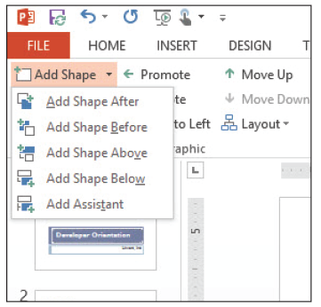
Step by Step: Add a Shape to a SmartArt Graphic
Click the Add Shape drop- down arrow in the Create Graphic group. PowerPoint displays a menu of options for adding a shape relative to the current shape (see the figure at right).
Click Add Shape Below. PowerPoint adds a sub- ordinate shape to the Pat Cramer shape.
Notes:
Take Note: Notice that the new shape, which is on a new level, has a different theme color to differentiate it from the level above.

Slide 24
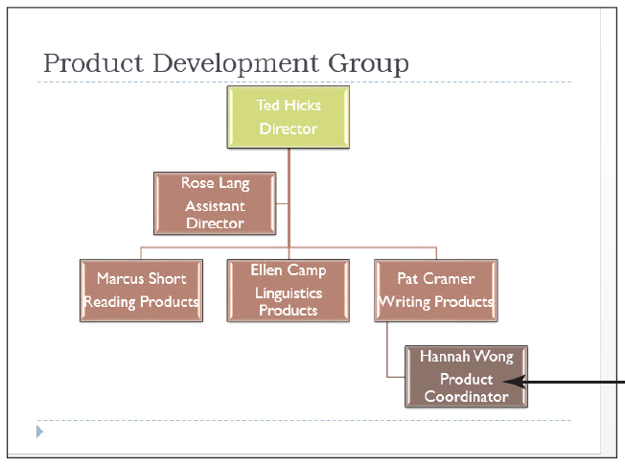
Step by Step: Add a Shape to a SmartArt Graphic
Type Hannah Wong in the new shape, press Enter, and type Product Coordinator. Then click away from the graphic to deselect it. The slide should look similar to the figure at right.
Select Hannah Wong’s shape. On the SmartArt Tools Design tab, click the Add Shape drop-down arrow, and then click Add Shape Below. PowerPoint adds a subordinate shape.

Slide 25
Step by Step: Add a Shape to a SmartArt Graphic
Type Allan Morgan into the new shape, press Enter, and type Software Design.
With Allan Morgan’s shape still selected, click the Add Shape drop-down arrow, and then click Add Shape After. PowerPoint adds a shape on the same level.
Type Kyle Porter in the new shape, press Enter, and type Package Design.
Notes:
Take Note: In step 9, had you clicked the face of the Add Shape button rather than its arrow, PowerPoint would have added a new shape subordinate to the selected one.

Slide 26
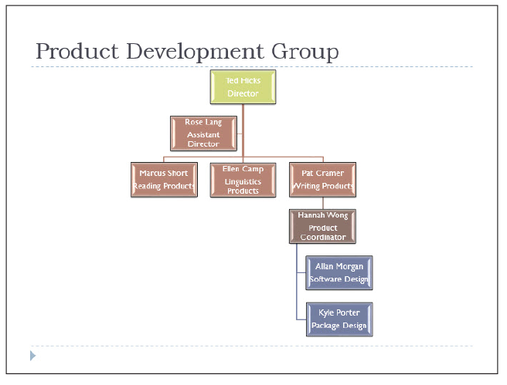
Step by Step: Add a Shape to a SmartArt Graphic
Click away from the graphic to deselect it. Your slide should look similar to the figure at right.
SAVE the presentation.
PAUSE. LEAVE the presentation open to use in the next exercise.

Slide 27
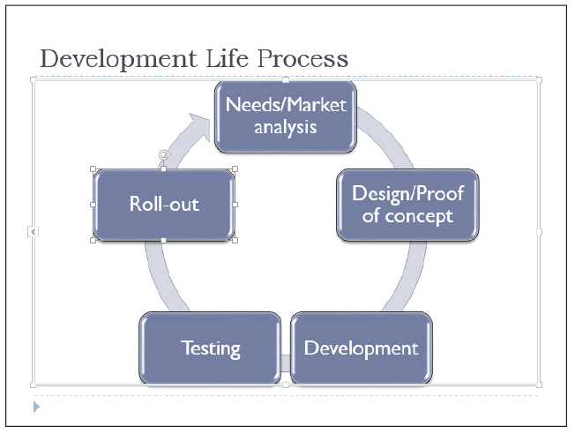
Step by Step: Remove a Shape from a SmartArt Graphic
USE the Litware Final presentation that is still open from the previous exercise.
Go to slide 4, and click the SmartArt graphic to select it.
Click the Update shape to select it. Make sure you select the shape, and not the text within it.
Press Delete. PowerPoint removes the shape and reconfigures the SmartArt graphic (see the figure above).
SAVE the presentation.
PAUSE. LEAVE the presentation open to use in the next exercise.

Slide 28
Step by Step: Reverse Direction
USE the Litware Final presentation that is still open from the previous exercise.
Go to slide 3 and click the SmartArt graphic to select it. Make sure you select the entire graphic.
Click the SmartArt Tools Design tab, if it is not already displayed.

Slide 29
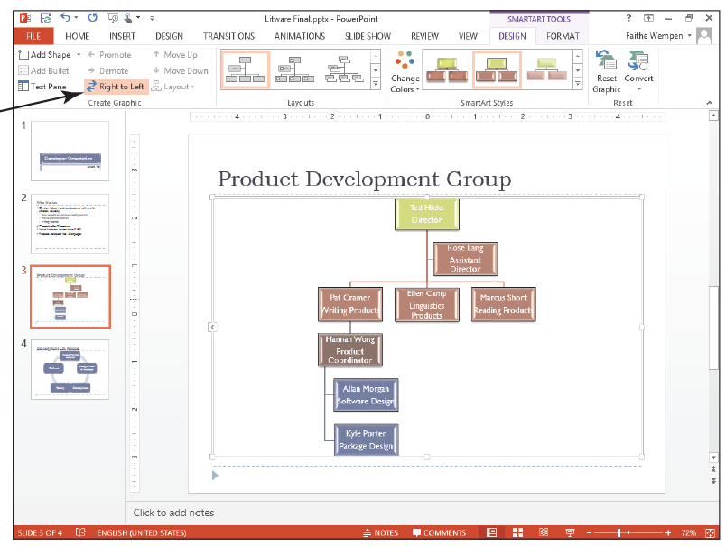
Step by Step: Reverse Direction
Click the Right to Left button in the Create Graphic group. PowerPoint flips the graphic horizontally so that shapes on the right side are now on the left side (see the figure at right).
Click in the top-level shape (Ted Hicks). Make sure you select the shape, and not the text within it.

Slide 30
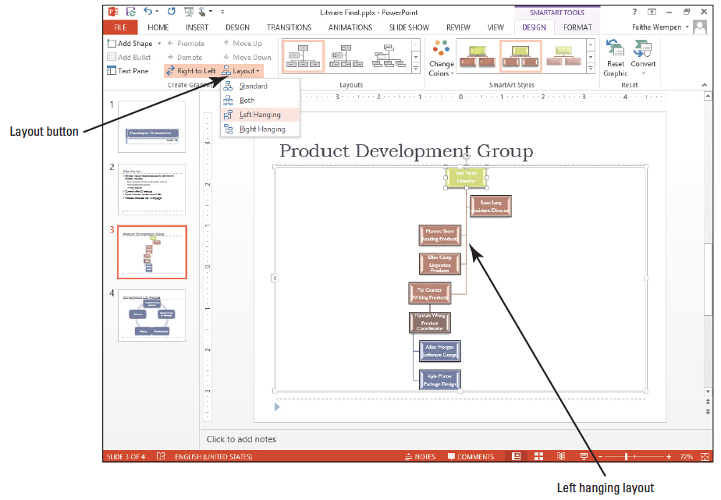
Step by Step: Reverse Direction
Click the Layout button in the Create Graphic group. PowerPoint displays options for positioning the shapes relative to the top-level shape.
Click Left Hanging. The subordinate shapes are arranged vertically below the top-level shape, rather than horizontally (see the figure above).
Click the Layout button, and then click Standard to restore the original layout.

Slide 31
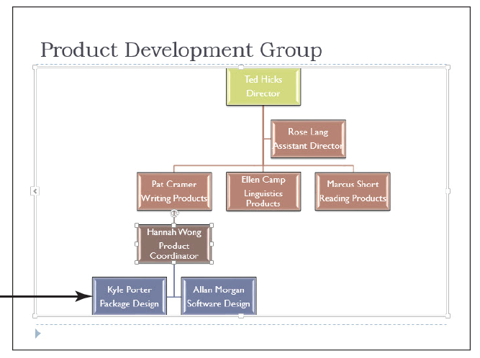
Step by Step: Reverse Direction
Click the Hannah Wong shape, click the Layout button, and then click Both. The subordinate shapes display horizontally rather than vertically (see the figure at right).
SAVE the presentation.
PAUSE. LEAVE the presentation open to use in the next exercise.

Slide 32
Step by Step: Move a SmartArt Shape
USE the Litware Final presentation that is still open from the previous exercise.
Go to slide 4 and click the SmartArt graphic to select it.
Click the Testing shape.
On the SmartArt Tools Design tab, click Move Down. The shape moves one position in a clockwise direction. Note that in this example, Move Down actually moves the shape upward in the graphic.
Click Move Up. The shape moves one position in a counter-clockwise direction.
SAVE the presentation.
PAUSE. LEAVE the presentation open to use in the next exercise.

Slide 33
Step by Step: Promote a Shape
USE the Litware Final presentation that is still open from the previous exercise.
Click the SmartArt graphic on slide 3 to select it, if necessary.
If the text pane is not already open, click the Text Pane button on the SmartArt Tools Design tab.
In the Text pane, click the Hannah Wong bulleted item. Notice in the Text pane that this item is indented below the Pat Cramer bulleted item.

Slide 34
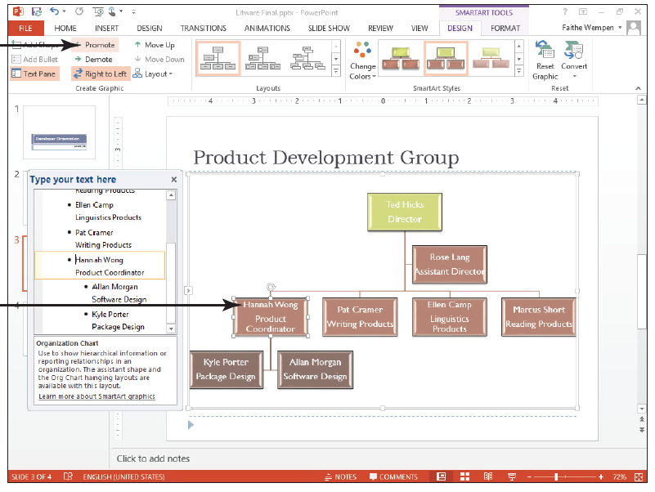
Step by Step: Promote a Shape
Click the Promote button in the Create Graphic group. Hannah Wong’s shape jumps up one level, and her two subordinates are also promoted (see the figure at right).
Click the Text Pane button to hide the text pane again.
SAVE the presentation.
PAUSE. LEAVE the presentation open to use in the next exercise.

Slide 35
Step by Step: Choose a Different SmartArt Type and Layout
USE the Litware Final presentation that is still open from the previous exercise.
Go to slide 4 and click the SmartArt graphic to select it.
Click the More… button in the Layouts group, and then click More Layouts at the bottom of the gallery to open the Choose a SmartArt Graphic dialog box.
Click the Process type in the left pane, then click the Upward Arrow layout in the center pane.

Slide 36
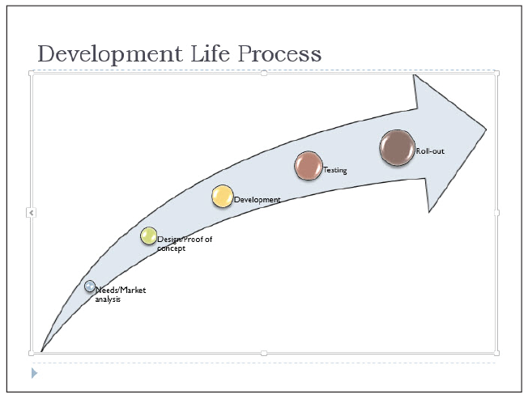
Step by Step: Choose a Different SmartArt Type and Layout
Click OK. PowerPoint converts the SmartArt graphic to the Upward Arrow type (see the figure at right).
SAVE the presentation.
PAUSE. LEAVE the presentation open to use in the next exercise.

Slide 37
Step by Step: Change Shape Size
USE the Litware Final presentation that is still open from the previous exercise.
Close the Text pane if it is open.
Select the SmartArt graphic on slide 4 if it is not already selected, and then click the Needs/Market Analysis circle (the circle nearest the thin end of the arrow graphic) to select it. Make sure you select the circle, not the text.
Click the SmartArt Tools Format tab.
Click the Larger button in the Shapes group twice to increase the size of the smallest circle.
Click the Design/Proof of Concept circle shape, and then click the Larger button once to increase the shape’s size.

Slide 38
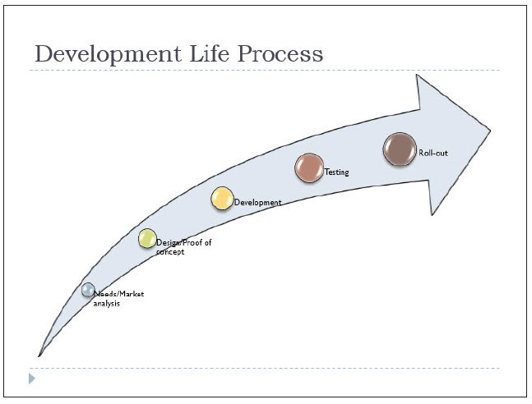
Step by Step: Change Shape Size
Click the Roll-out circle shape, and then click the Smaller button in the Shapes group once to decrease the shape size. Then click away from the graphic to deselect it. Your SmartArt graphic should look like the figure below.
Notes:
Troubleshooting: If you select the text box rather than the shape, click outside the text box to deselect it, and then try again by clicking the left edge of the shape with the four-headed pointer.

Slide 39
Step by Step: Change Shape Size
SAVE the presentation.
PAUSE. LEAVE the presentation open to use in the next exercise.
Notes:
Take Note: You can also change shape appearance by selecting a completely new shape: right-click a shape, click Change Shape, and select the desired shape from the Shapes gallery.

Slide 40
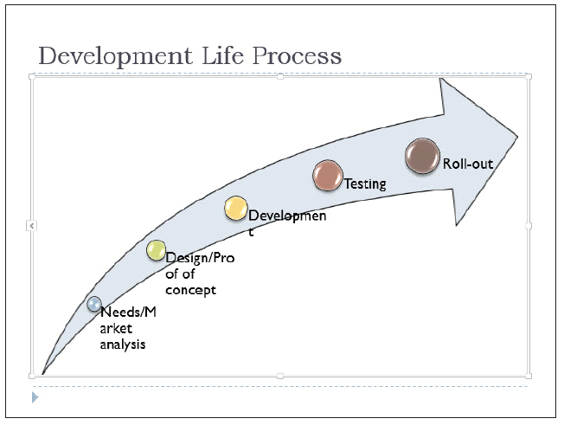
Step by Step: Change Text Formatting
USE the Litware Final presentation that is still open from the previous exercise.
On slide 4, select the outer frame of the SmartArt graphic (not a specific shape within it).
On the Home tab, click the Font Size drop-down arrow, and then click 20. PowerPoint changes the size of all text in the graphic to 20 point (see the figure above).

Slide 41
Step by Step: Change Text Formatting
Click the Needs/Market analysis text box and drag its border to reduce its width slightly so that the word Market moves completely to the second line.
Click the Design/Proof of concept text box and expand its width so that the word Proof displays completely on the first line.
With the Design/Proof of concept text box selected, press the right arrow key on the keyboard three times to move the text box slightly to the right so its text does not overlap the circle shape.

Slide 42
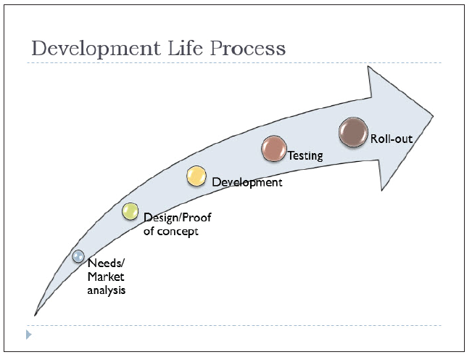
Step by Step: Change Text Formatting
Widen the Development text box so the word fits on a single line, and move the text box to the right slightly, as you did in step 5. Then click away from the graphic to deselect it. Your completed graphic should look similar to the figure at right.

Slide 43
Step by Step: Change Text Formatting
Go to slide 3 and click the SmartArt graphic to select it.
Click the outside edge of the Ted Hicks shape.
Click the Font Color drop-down arrow on the Home tab, and then click Black, Text 1. The text in that shape is now easier to read against the light green fill.

Slide 44
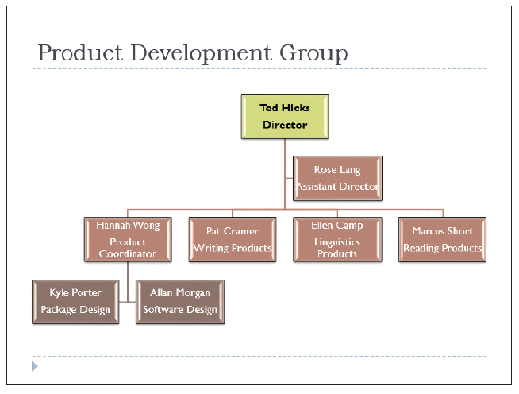
Step by Step: Change Text Formatting
Click the Bold button on the Home tab. All text in the shape is bolded. Then click away from the graphic to deselect it. Your graphic should look like the figure at right.
SAVE the presentation.
PAUSE. LEAVE the presentation open to use in the next exercise.

Slide 45
Step by Step: Convert SmartArt
USE the Litware Final presentation that is still open from the previous exercise.
Go to slide 4 and select the SmartArt object.
On the SmartArt Tools Design tab, click the Convert button, then click Convert to Text from the menu that appears. The SmartArt is converted to a bulleted list.
Go to slide 3 and select the SmartArt object.
On the SmartArt Tools Design tab, click the Convert button, and then click Convert to Shapes. The diagram changes to a set of shapes.

Slide 46
Step by Step: Convert SmartArt
Click inside the diagram to confirm that the SmartArt tabs on the Ribbon do not appear.
Click one of the diagram's shapes. Notice that the Drawing Tools Format tab becomes available, indicating it is a drawn shape object.
SAVE the presentation and CLOSE it.
EXIT PowerPoint.

Slide 47
Skill Summary

